Slide 1
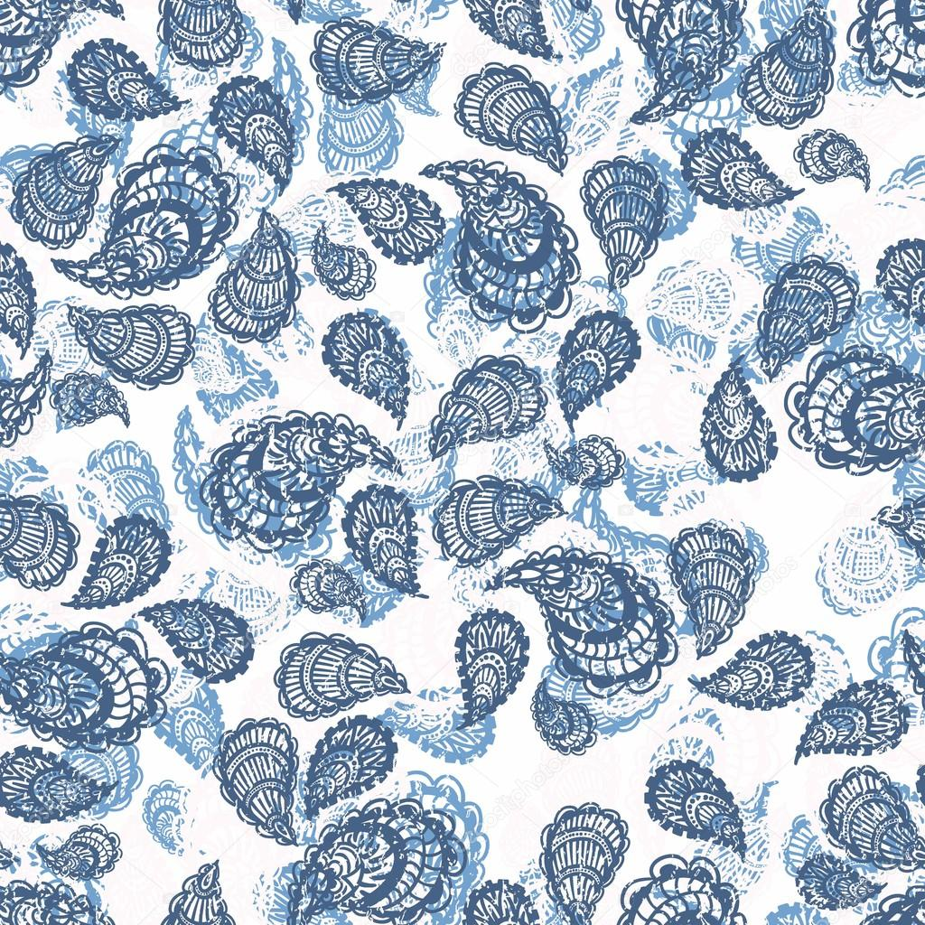
Presentation on the topic: «National turkish costume»

Slide 2
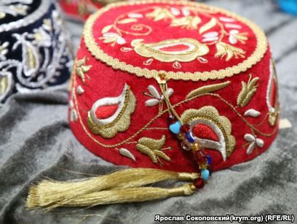
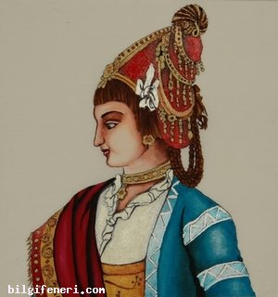
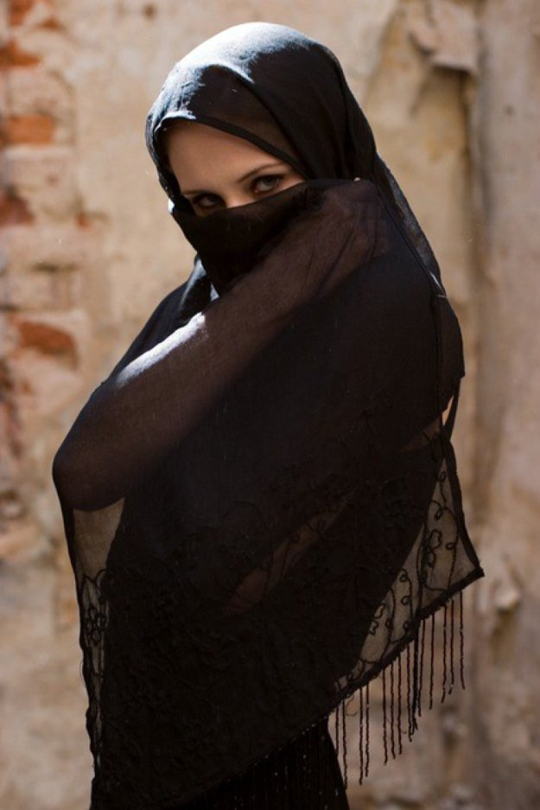
Her head was covered with at cap or from the XVII century and a veil.

Slide 3
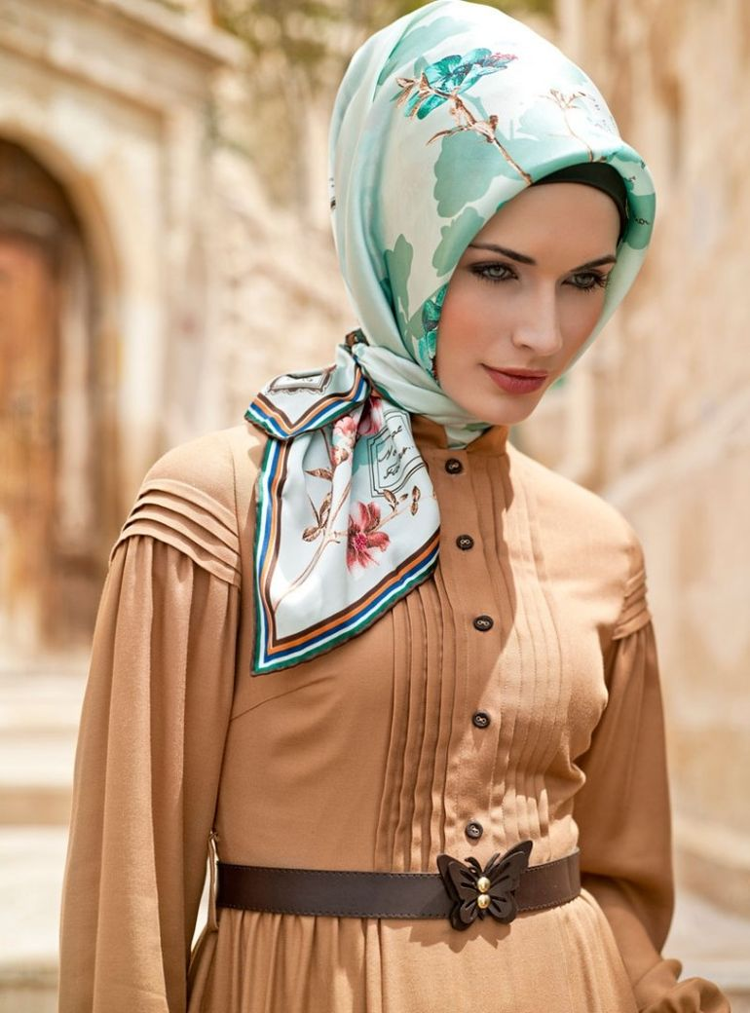
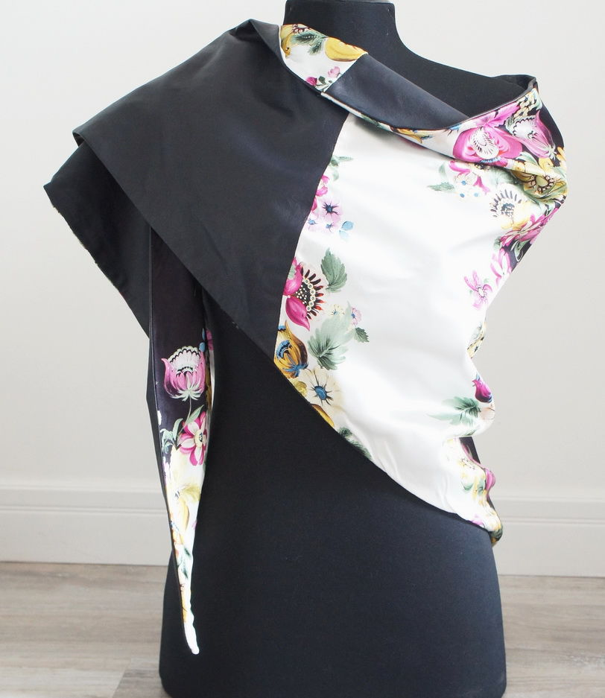
Greet,Armenian,Jewish,Hamgarian could wear a fustanella skirt? Loose pants made of blue fabrics and tie their heads with satin(for Creet women) or lether(for American women) handderchiefs.

Slide 4
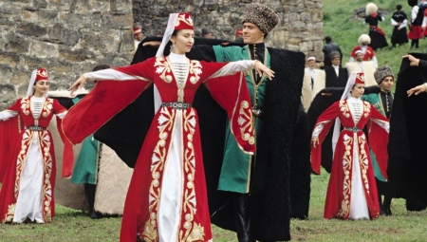
Time went, costumes were ehanged. Some elements have been preserved? Preserving thus thir original, others have disappeared alt.

Slide 5
Thanks for attention.

