Slide 1
Презентация по английскому
Константинова Алина. 7 «М».

Slide 2
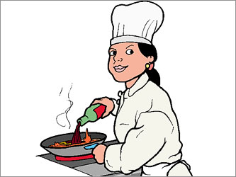
Unfortunately, I can not say who I will in ten years, or what I do, but I have someaspirations and dreams, so I have hope and faith in my future. When I track the status of adult life, I would like first to have a family. but before this study in a good profession. I dream of the happy future of our country, and what I can I help it that it grew and bloomed. I believe in the happy future of his and his country.

Slide 3
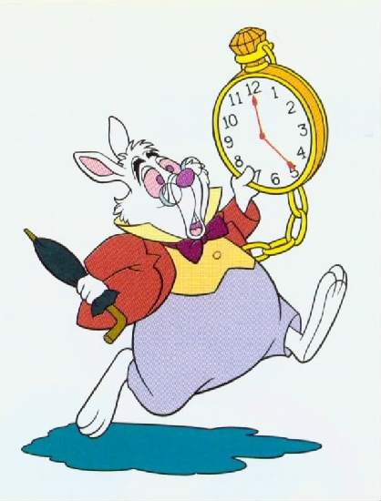
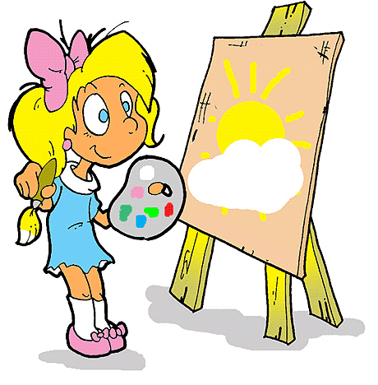
In ten years, most of all I would like to be more accurate, creative and punctual.

Slide 4
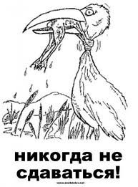
Your motto «Never give up!».

Slide 5
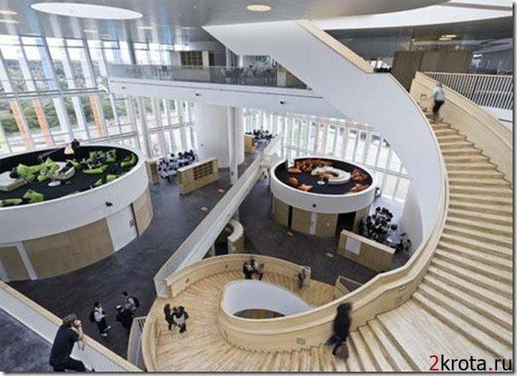
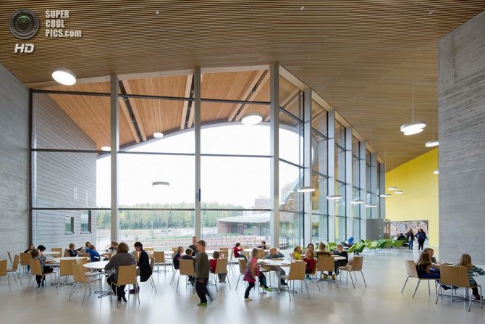
For school need the best conditions,and ooperati on science and protalkivanii in the future,I will acquaintance with his school after ten years of doing this: first you need a good, expensive class,which will be ten most plasma instead of the usual dociu each student instead of desks touch the table on which he will be able to solve problems and the teacher to check on the spot. For Russian good will audiosource that will help you write well dictatin the lesson of history is machine-the time by which we will be able to observe the culture in 10-20 Makaha in geography we will be able to go to other countries,considering the most wonderful sights. Biology lesson will be real,we will be able to go to space and see every human body or plants. The school will be very beautiful scene,which will help to make the performance of Iwill discos will be very zamanchivye dining room will be delicious food,for everyone will be your waiter and minutage will lounge,which will help the child to relax and continue to learn.

Slide 6
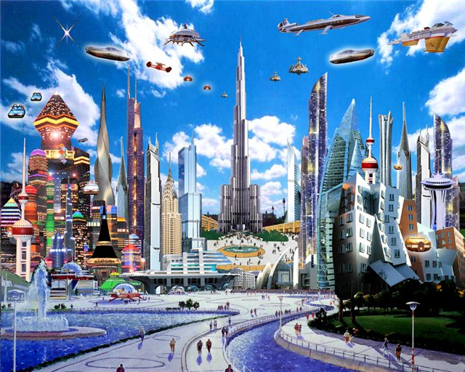
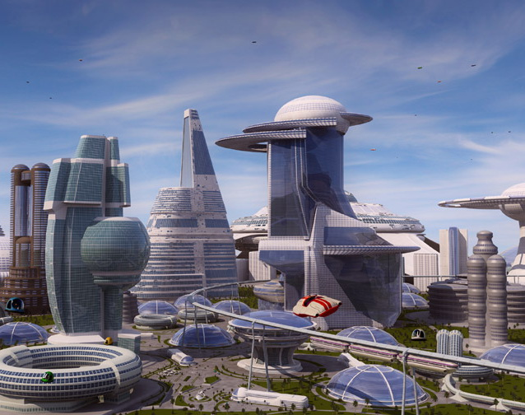
What will be our planet ten after years.
I can not imagine how can change our planet. It can be new technologies, like computers in our bodies. Or different robots, hwo can make our housework like water plants in the garden. Also maybe we will can fly without helicopters. Can will be everything, because all people are different.

