Slide 1
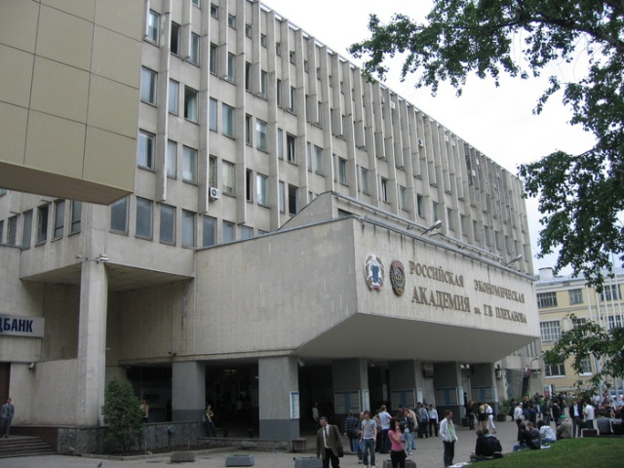
Нistory of University:
Russian Economic University named after GV Plekhanov is located in Moscow. Plekhanov Russian University of Economics began its work in 1907 as a private college, and received university status in 2010 only. But, nevertheless, it has already become one of the largest educational and scientific centers for training and retraining of highly skilled experts in the field of technology, economy and technology. .

Slide 2
Faculties:
Faculty of Finance, Faculty of Marketing, Faculty of Engineering and Economics, Faculty of Business, Faculty of Management, Faculty of Trade Economics and Commodity Science, Faculty of General Economics, Faculty of Law, Faculty of International Economic Relations, International Business School (IBS - Plekhanov), Faculty of additional professional education, Faculty of Distance Learning, Faculty "High School of Hotel, Tourism and Sport Industry", Plekhanov Business School Integral, Faculty of Mathematical Economics and Informatics, Faculty of Service.

Slide 3
University structure:
Office of Information, the center of humanitarian training, publishing center, Scientific Information Library Center Academician LI Abalkina, career development center, hostel for foreign students, a sanatorium, an association of graduates.

Slide 4
Leisure in the university:
1) The House of Culture of the university «Congress Centre».2) Student Club song «Me and My Guitar».3) The dance troupe «Helikon».4) The University has its own sports club, billiard club, gym, Fight Club, in which students are engaged in boxing, karate and kickboxing, as well as sections where children can enjoy volleyball, football, table tennis, rugby, hockey and basketball.5) Team cheerleader SABOTAGE.6) Fitness Centre and Anapa.

Slide 5
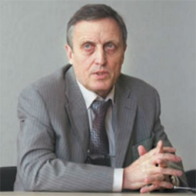
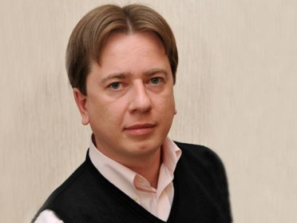
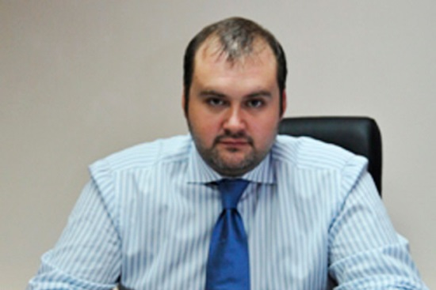
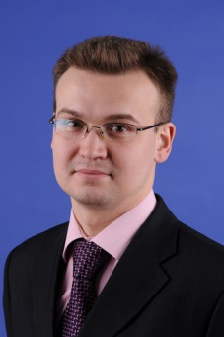
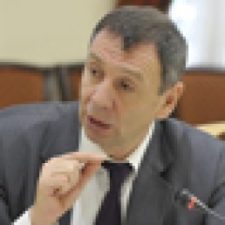
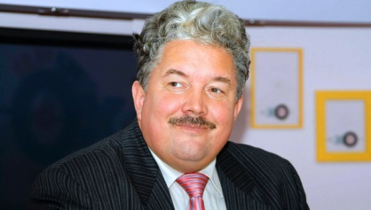
teaching staff:
The University has more than 1,200 teachers, among them more than 260 doctors, more than 180 professors and more than 630 candidates of sciences and 420 associate professors.

Slide 6
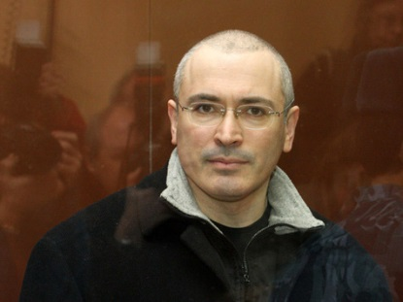
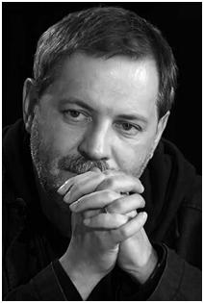
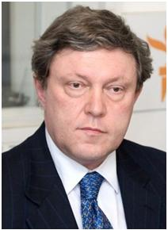
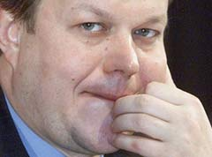
The famous graduates:
Khodorkovsky Mikhail , entrepreneur, previously headed the list of richest Russians according to the magazine «Forbes». Mikhail Leontiev, a Russian journalist, TV presenter «However», a member of the party «United Russia» .Grigory Yavlinsky, in the years 1993-2008 the head of the party «Apple». Yury Scheffler, Russian millarder etc.

