Slide 1
Smolensk State University
/

Slide 2
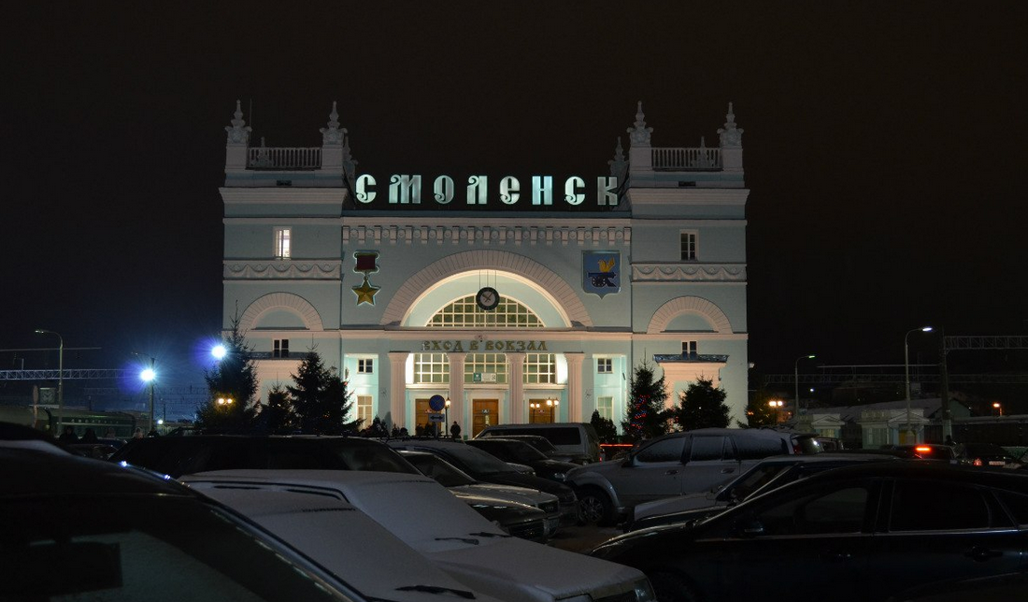
/
The Smolensk State University is situated in Smolensk.

Slide 3
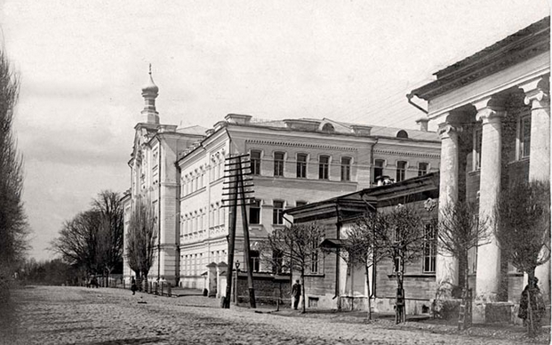
The Smolensk State University is one is oldest university of Russia. It formed in 1918. In 1998 it became «The Smolensk State Pedagogic University» and in 2005 it became «The Smolensk State University»

Slide 4
There are courses of foreign language, computer technology.

Slide 5
You can get the degree of Bachelor and Master`s degree.

Slide 6
There are 8 faculties: the faculty of science, the faculty of history, the faculty phycology and pedagogues, the social faculty, the faculty Physics and Mathematics, the philological faculty, the faculty of Art, the faculty economics and management.

Slide 7
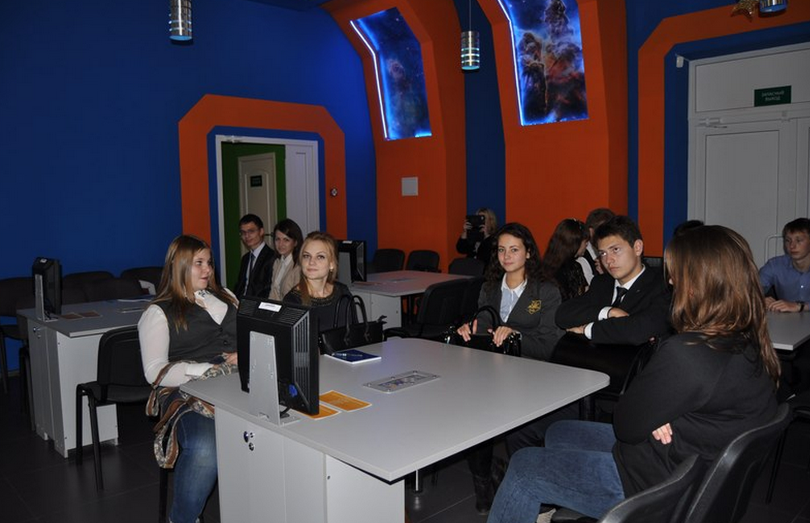
The university contacts with American company «Cisco». There is the informational center «Rosatom»

Slide 8
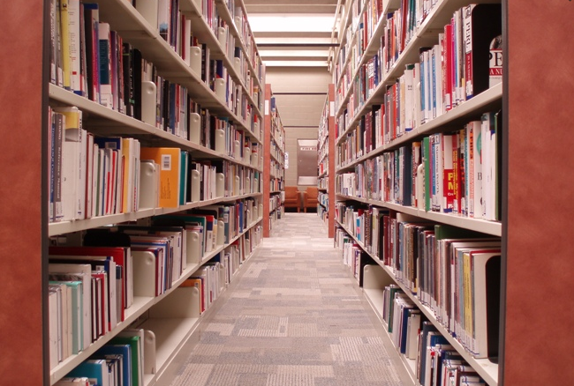
There is a library of the Smolensk State University. Here you can find more than 780,000 different books and magazines. There is interactive access to the catalogues of the library.

Slide 9
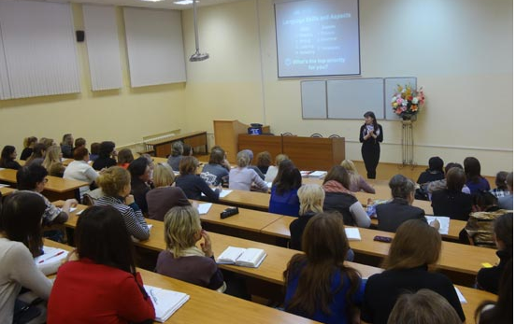
There are more than 4000 students at the University, there are 75 professors of the University avid 300 docents.

Slide 10
The University goes in for projects in the Sphere of Mathematics, Biology, Philology, History, Pedagogic.

Slide 11
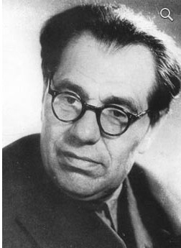
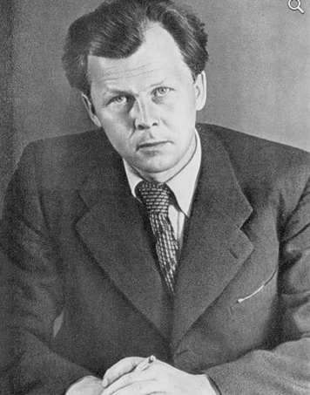
Many famous people were studding at the University, for example, A.T. Tvardovsky, N.I. Rylenkov, M.V. Isakovsky, V. M. Khvatov, M.B. Khrapchenko and other.
N.I. Rylenkov
A.T. Tvardovsky

Slide 12
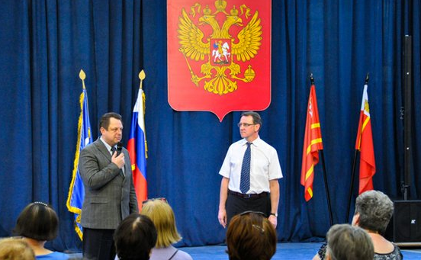
This University gives a high quality of education, it gives classical education which is important for modern society.

Slide 13
thank you!

