Slide 1
Welcome to Saturn!
Passrort of the planet

Slide 2
name:Saturn adress:The Solar system ,the milky way , the galaxy ,the universe age:21 million years! neighbours: Titan , Mimas ,Pandora ,Diona,Tefia and Feba (the biggest)

Slide 3
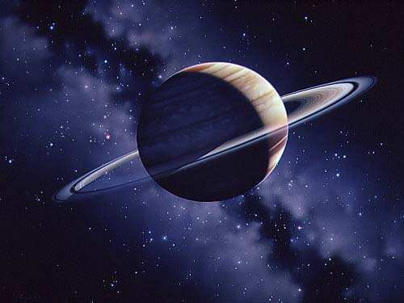
Saturn

Slide 4
