Slide 1
The Mars
PASSPORT

Slide 2
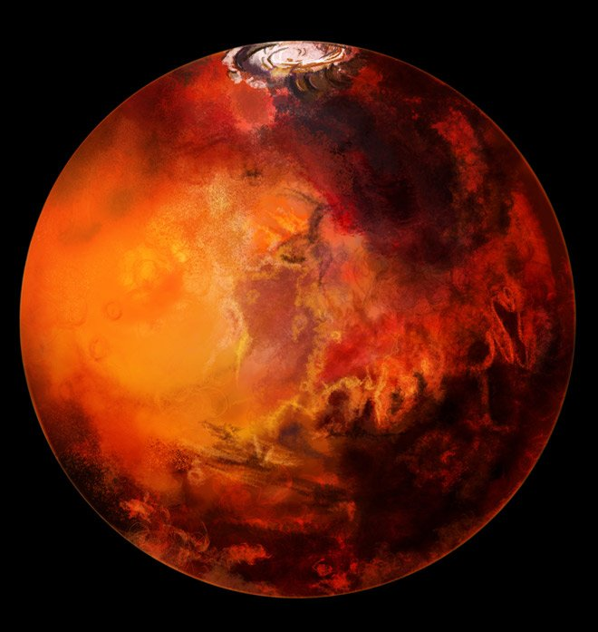
Name : the Mars

Slide 3
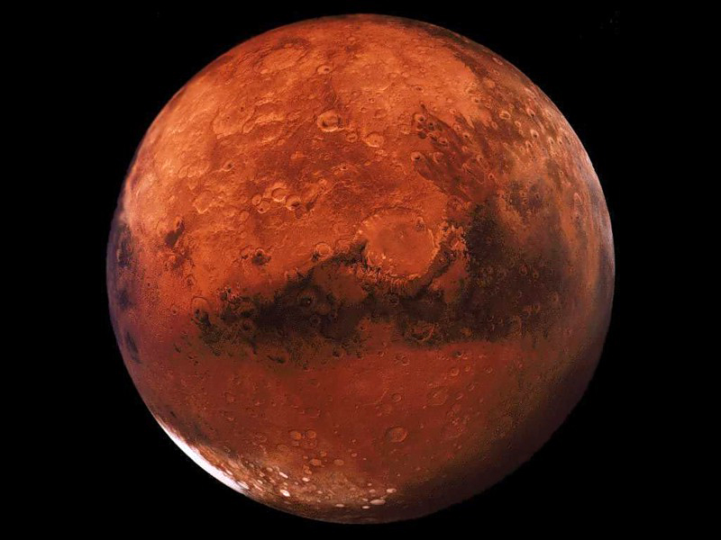
Other name: the Red Planet

Slide 4
Address : the Solar System, the Milky Way , the Galaxy, the Universe

Slide 5
Weight:
6.42×10²³ kilogram
Age:
4,65 milliard years

Slide 6
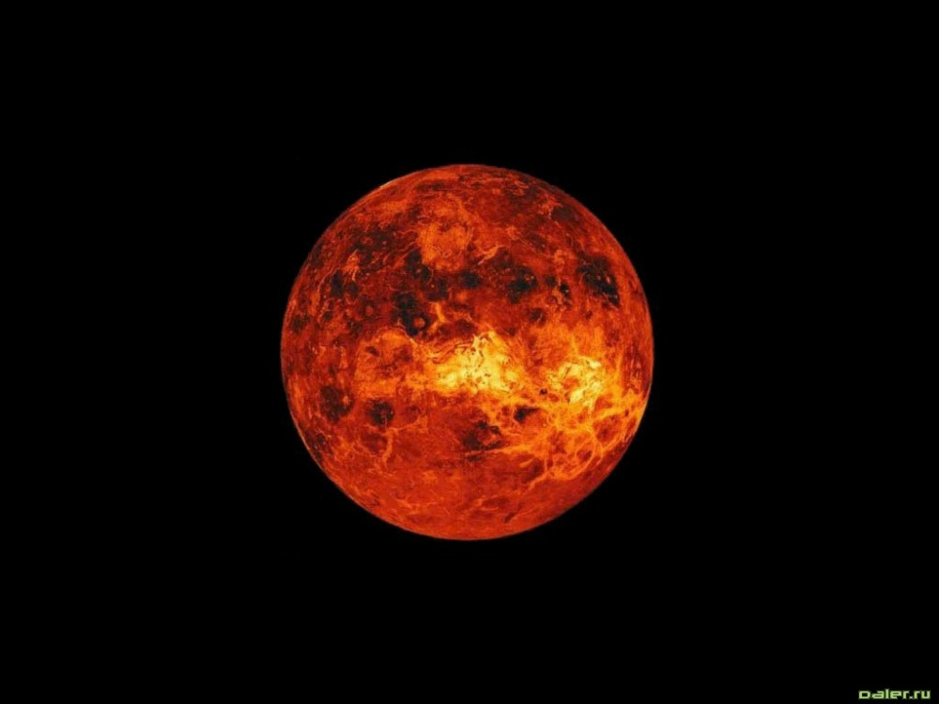
Color:
Red, orange, brown.

Slide 7
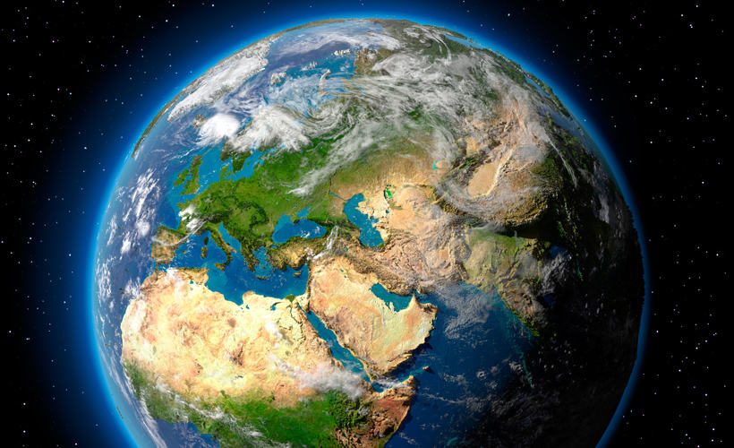
Closest neighbour : the Earth

Slide 8
The Mars is seventh largest of the nine main planets in the solar system.
It is the four planet from the Sun.

Slide 9
