Slide 1
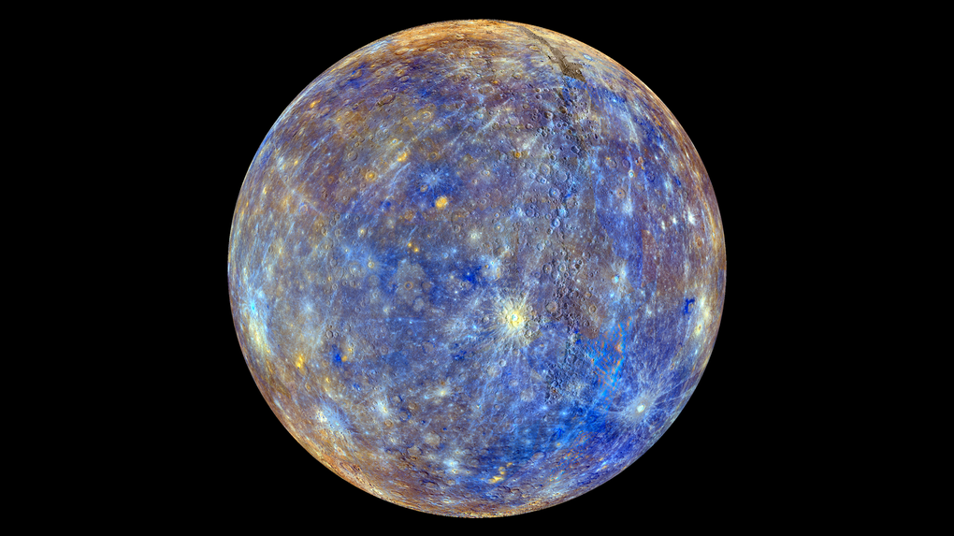
Меркурий
Mercury

Slide 2
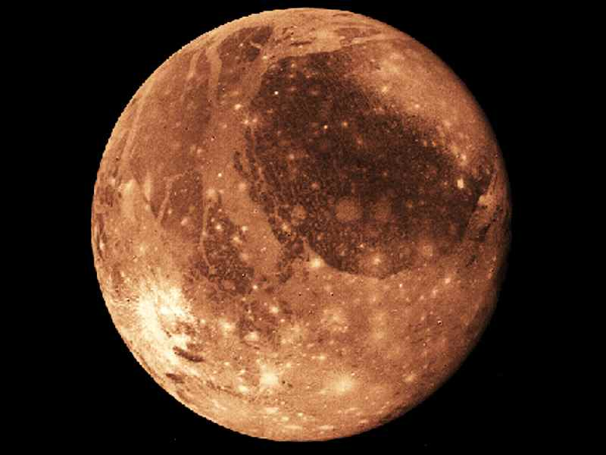
passport
name: mercury
Address:the solar system, the milky way, galaxy, the universe
Weight: 3.3 * 10.3
Age:4.600 million year
Color: brown
Closest neighbours: ----
Hobbies: space travel

Slide 3
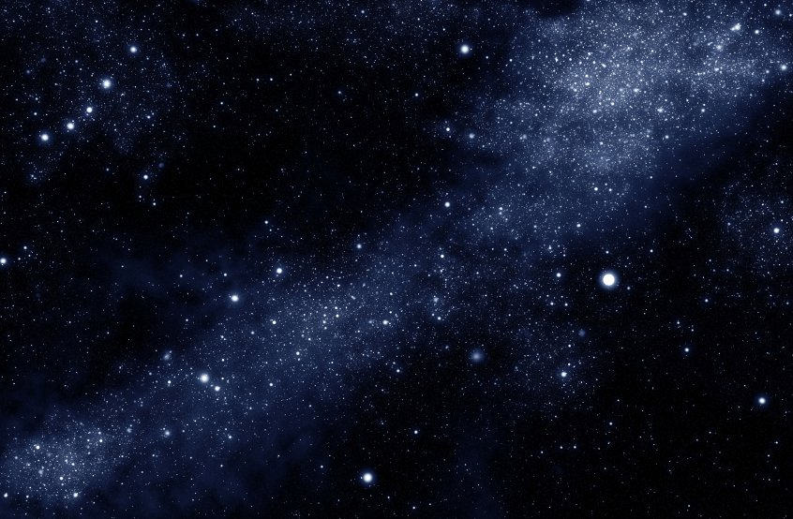
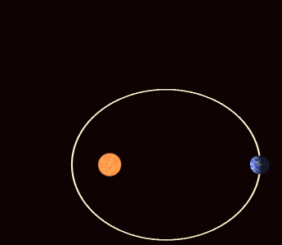
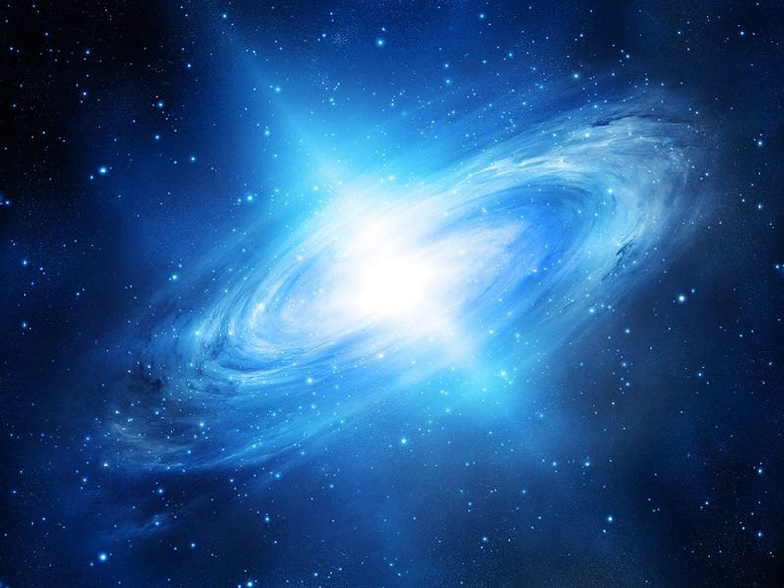

Slide 4
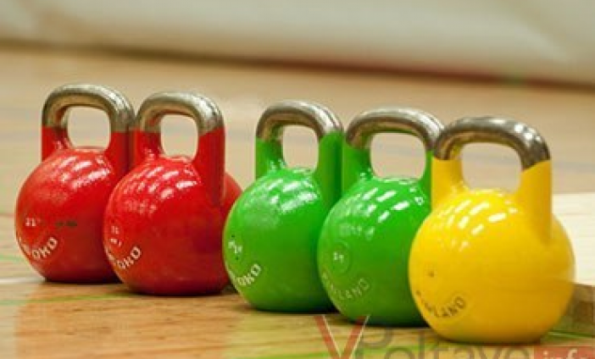

Slide 6
