Slide 1
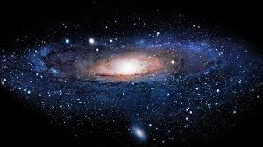
Passport planet “Mars”
Passport the planet “Mars”

Slide 2
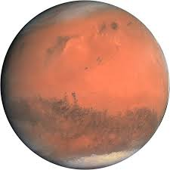
Name: Mars
Other name: Red planet
Address: Solar system
Weight: 6,4185·10²³ кг
Colour: red , black
Occupation: to be sweet home of Marsians
Hobbies: travelling round the sun

