Slide 1
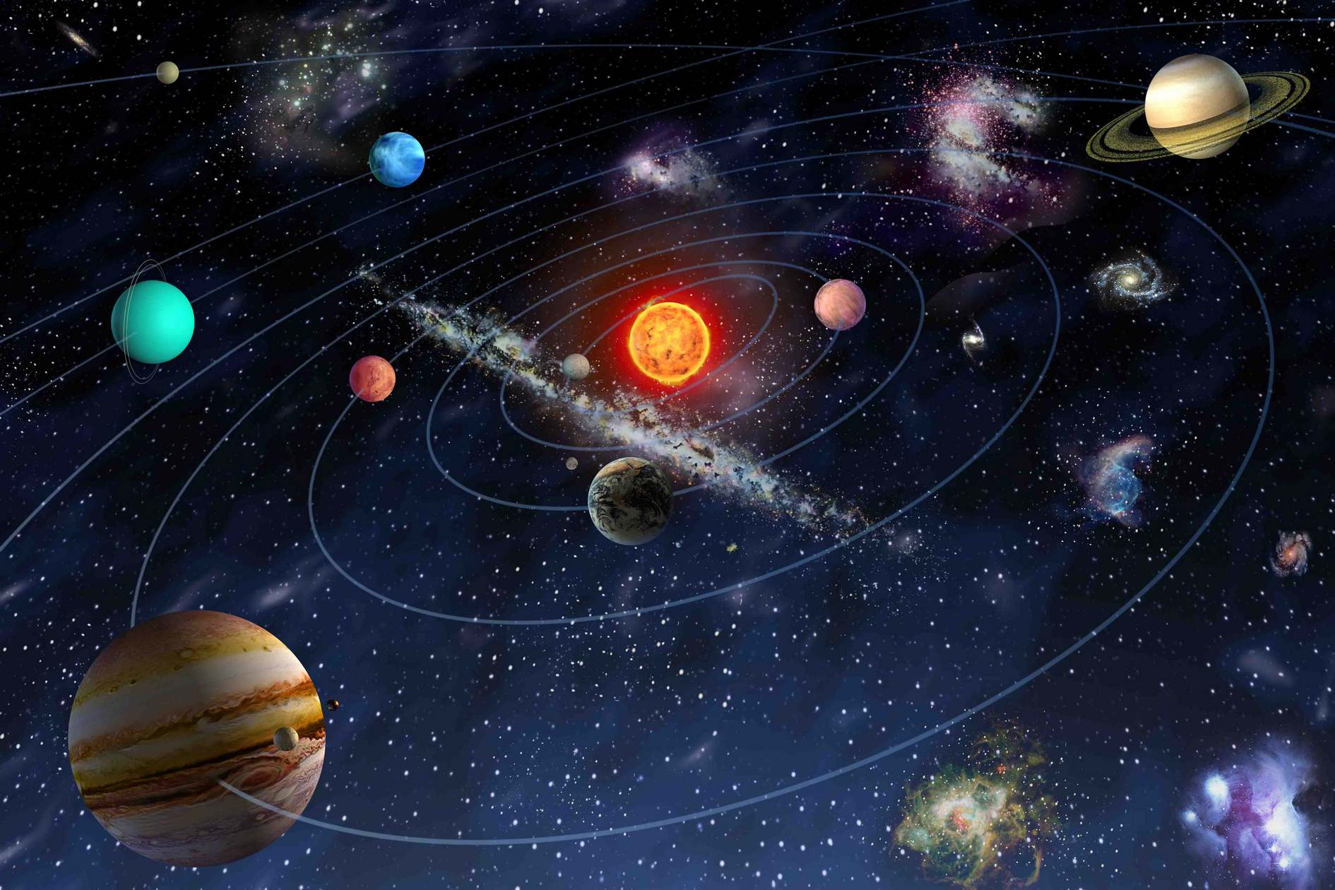
OUR WORLD PASSPORT

Slide 2
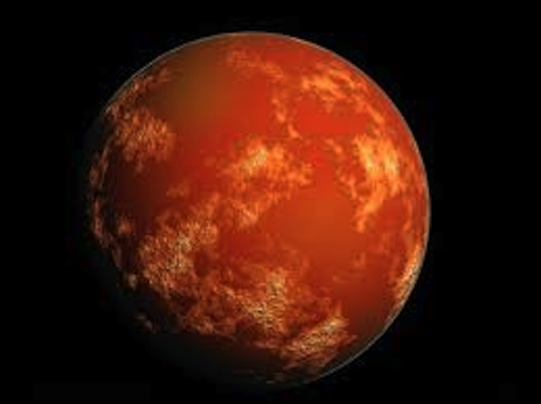
Name: Mars, The Red Planet.
People call Mars <The Red Planet> because the soil of Mars contains large amounts of iron.

Slide 3
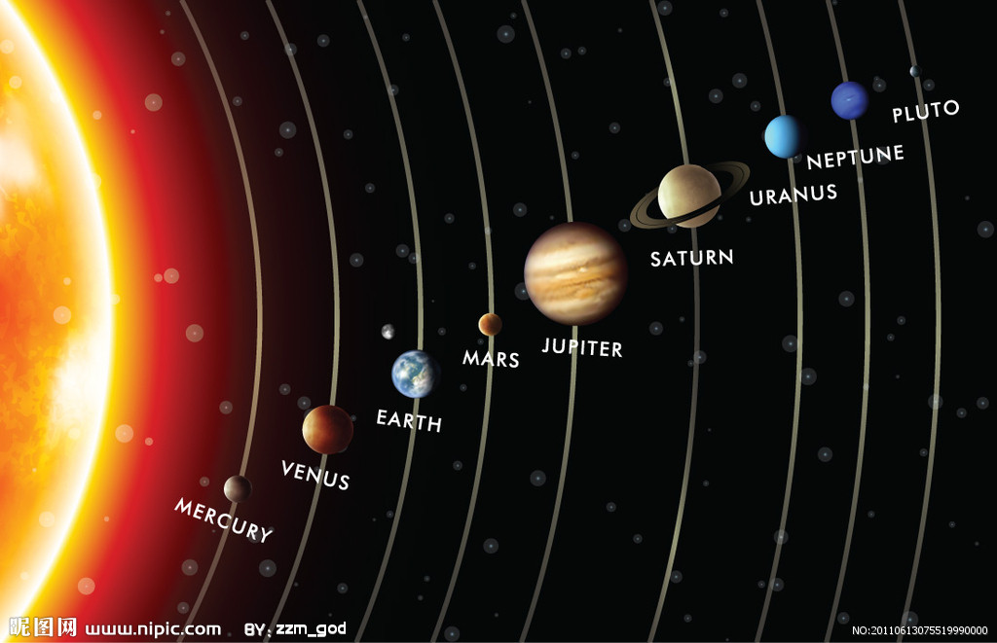
Mars is the fourth from the Sun and the ninth to size planet in the solar system.
Address: the Solar System, the Milky Way, the Galaxy, the Universe
Mars is the fourth from the Sun and the ninth to size planet in the solar system.

Slide 4
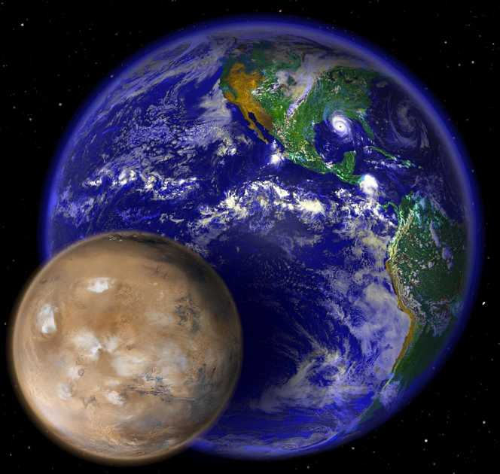
Weight: the 10,7% from weight of the Earth.

Slide 5
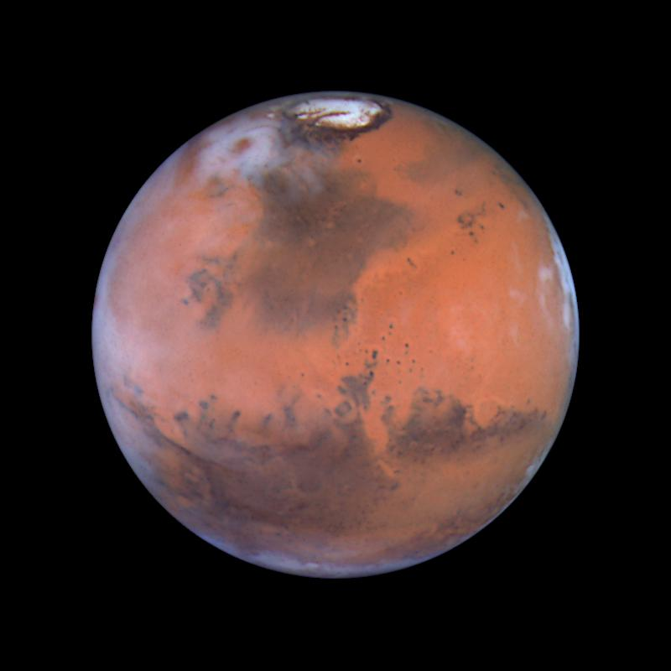
Age: 4,65 billion years.

Slide 6
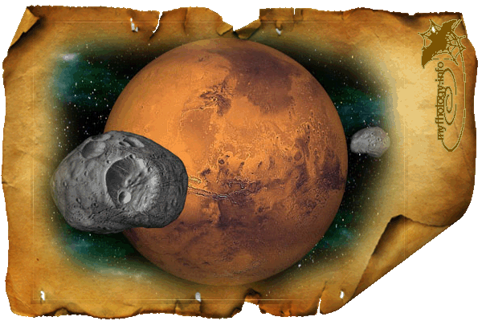
Closest neigh: Deimos and Phobos.

Slide 7
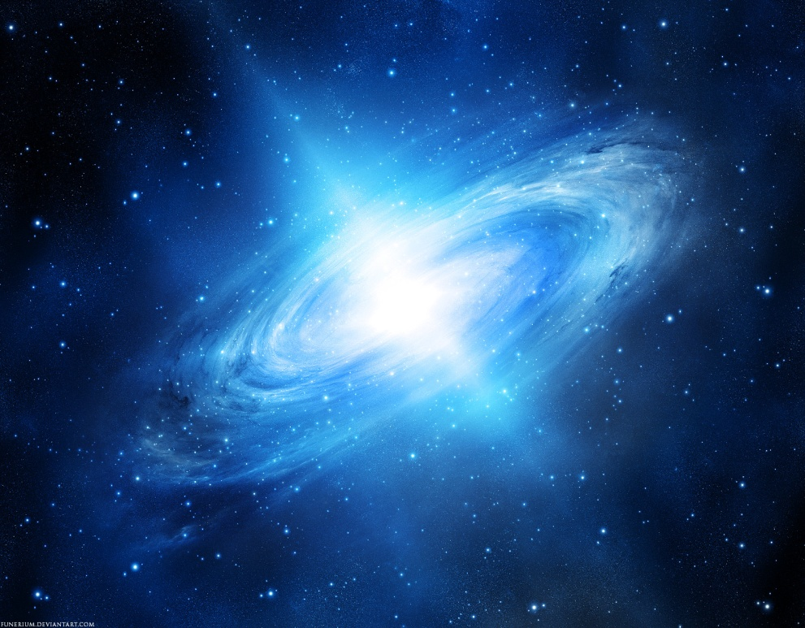
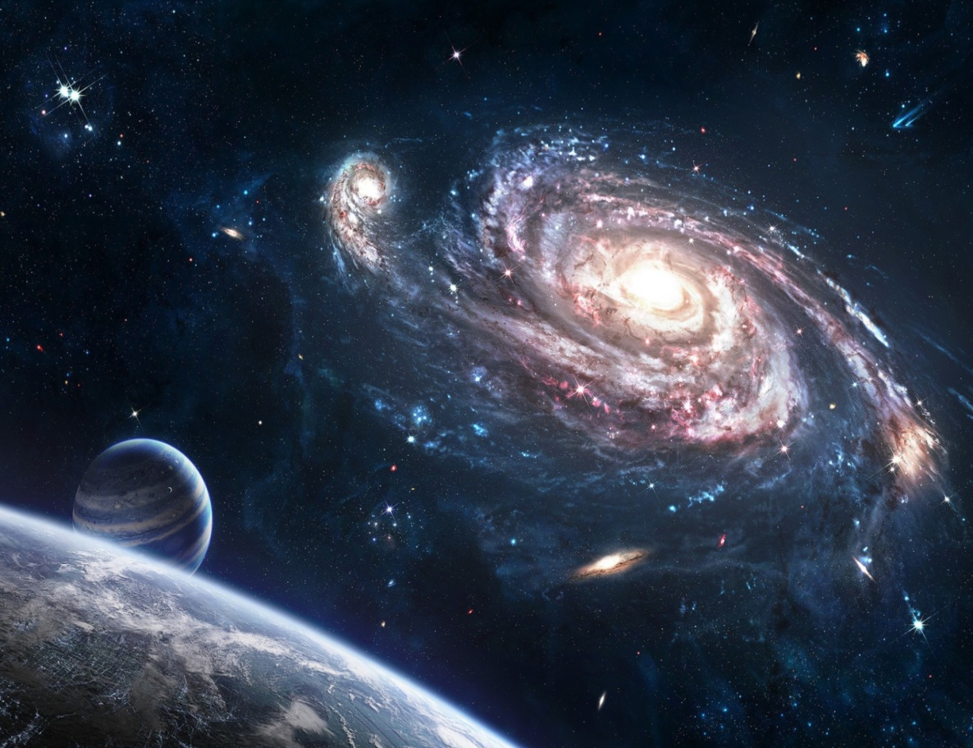
Hobbies: space travel

