Slide 1
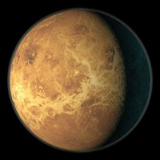
VENUS PASSPORT
Name: The Venus
Address: the Solar System, the Milky Way, the Galaxy, the Universe
Weight: 1,23 times smaller than the mass of the Earth
Age: 4,6 billion years
Color: Smooth white, patchy light green, sand
Closest neighbours: the Earth
Hobbies: space travel

Slide 2
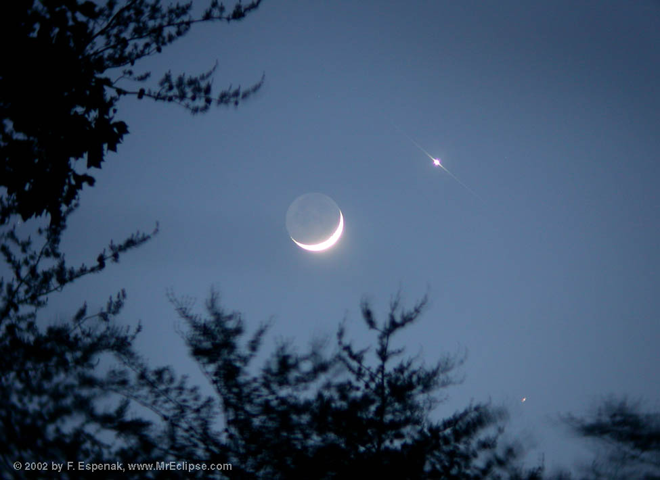
It named after Venus, the goddess of love in Roman pantheon. This is only one of the eight major planets in the solar system,was named in honor of a female deity.

Slide 3
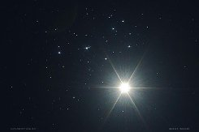
Venus is easy to recognize, because of the brilliance of it is much greater than the brightest stars.

Slide 4
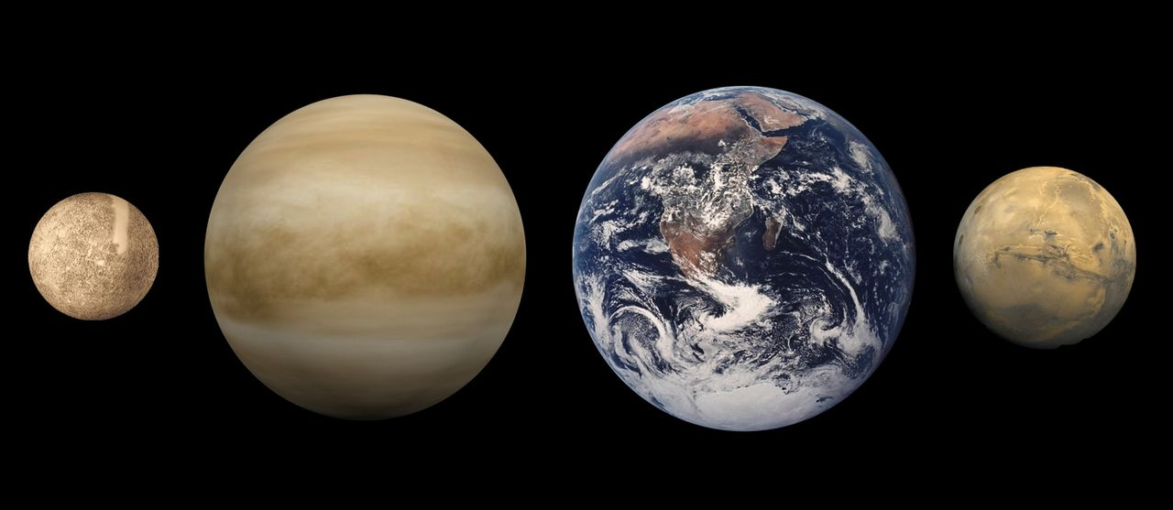
Venus - the second planet of the inner solar system Venus - the third brightest object in the sky after the Sun and the Earth's Moon

Slide 5
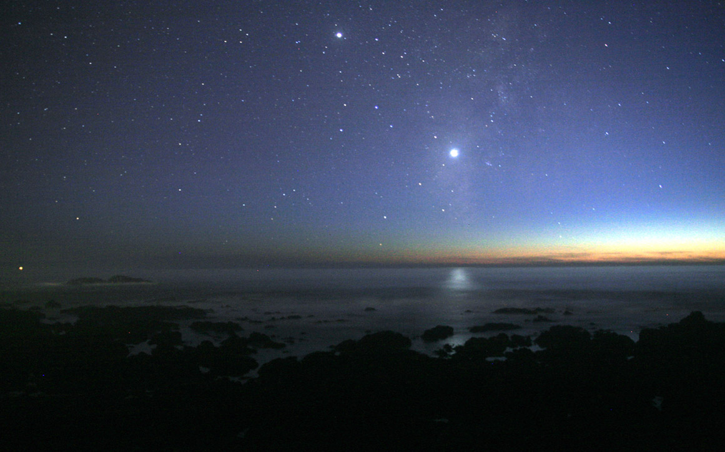
Venus is classified as Earth-like planets, and sometimes it is called "Earth's sister planet" because the two planets are similar in size, gravity and composition dnako conditions on the two planets are very different. The atmosphere of Venus, the densest among the terrestrial planets, primarily composed of carbon dioxide. The planet's surface is completely conceal an extremely thick clouds of sulfuric acid, opaque to visible light. The debate about what is under the thick clouds of Venus lasted until the XX century. At the same time the atmosphere of Venus is transparent to radio waves, through which subsequently was investigated by the relief of the planet.In ancient times, Venus is believed to be warmed up so that like Earth's oceans, which are believed she had completely evaporated, leaving behind a barren landscape with lots of rocks plitopodobnyh.

Slide 6
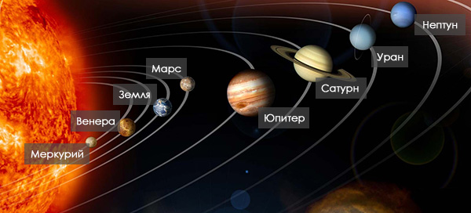
THE END!

