Slide 1
Bermuda Triangle

Slide 2
The Bermuda Triangle, also known as the Devil's Triangle, is a loosely defined region in the western part of the North Atlantic Ocean, where a number of aircraft and ships are said to have disappeared under mysterious circumstances. According to the US Navy, the triangle does not exist, and the name is not recognized by the US Board on Geographic Names. Popular culture has attributed various disappearances to the paranormal or activity by extraterrestrial beings.

Slide 3
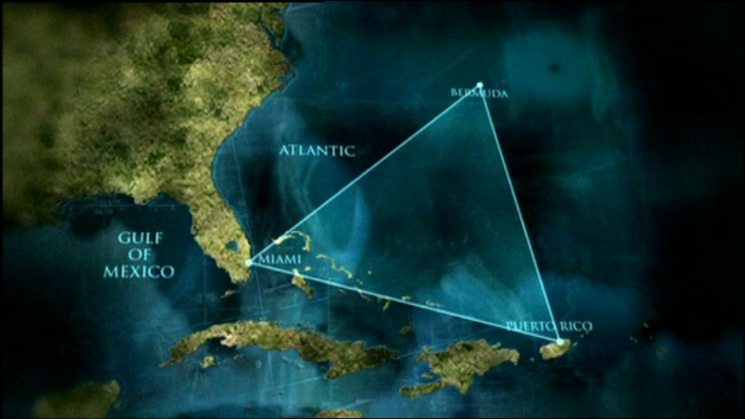

Slide 4
Documented evidence indicates that a significant percentage of the incidents were spurious, inaccurately reported, or embellished by later authors . In a 2013 study, the World Wide Fund for Nature identified the world’s 10 most dangerous waters for shipping, but the Bermuda Triangle was not among them

Slide 5
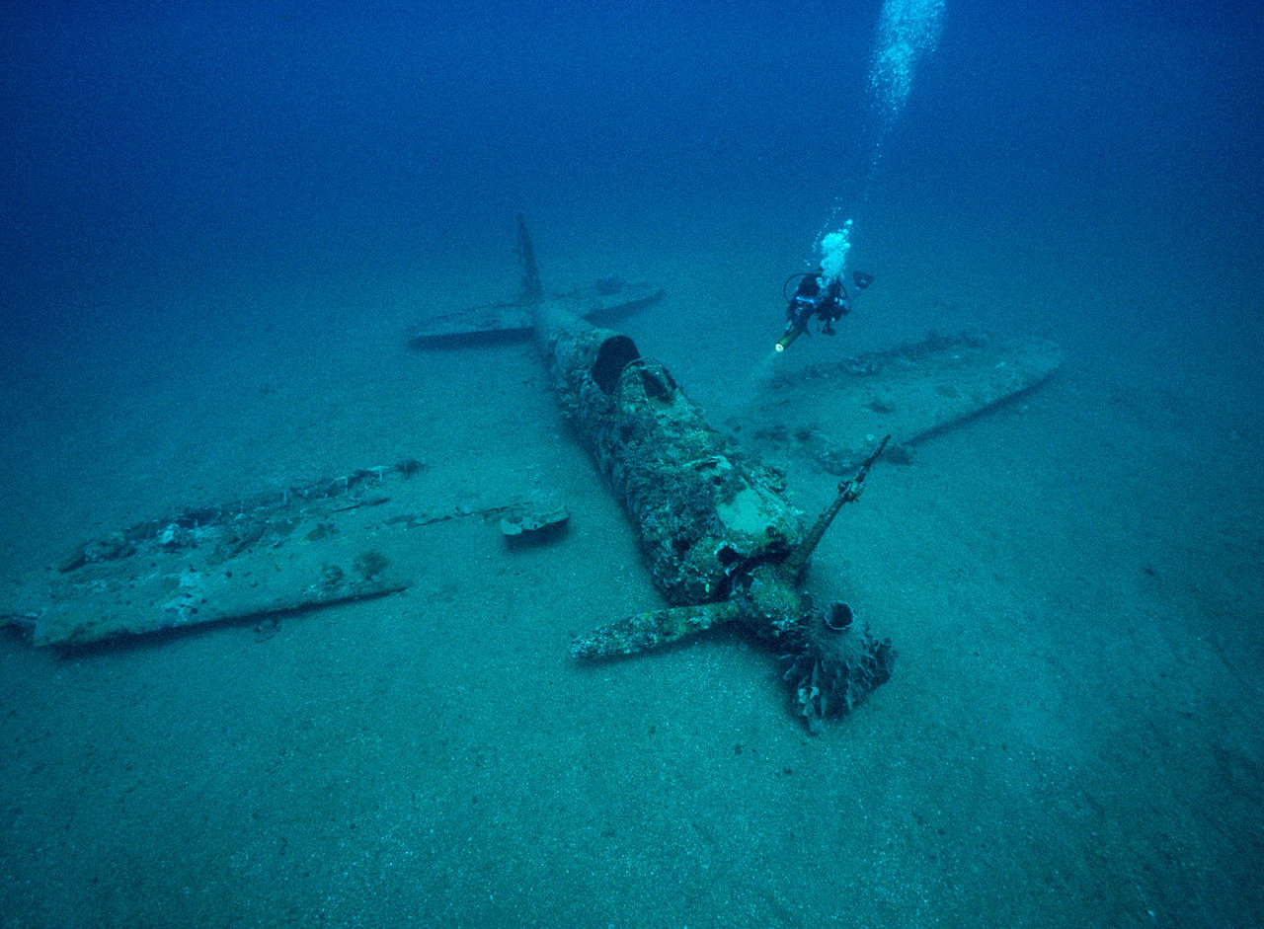
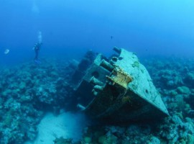

Slide 6
Proponents of the theory mention the disappearance of about 100 large ships and aircraft in the last hundred years. Also disappearances , reports on the serviceable ships , abandoned by the crew , and other unusual events , such as the instantaneous movement in space , anomalies with time , and so on . N . Lawrence Kusche and other researchers have shown that some of these cases took place outside of the Bermuda Triangle . Some incidents did not manage to find any information from official source

Slide 7
Thank you for the attention

