Slide 1
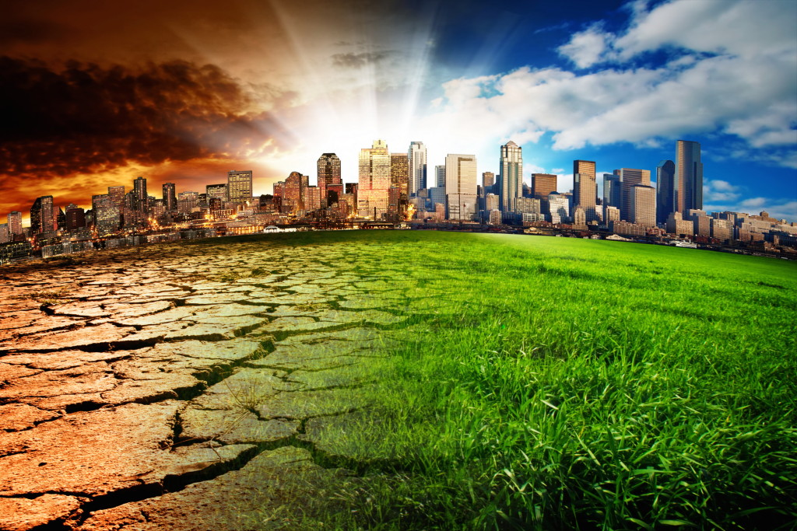
Pollution of the world

Slide 2
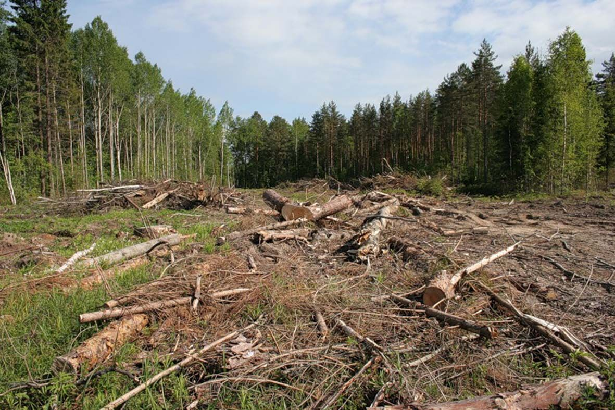
problems of the world
Many species of animals and birds have disappeared. Millions of animals die every year because people has polluted their naturals homes.

Slide 3
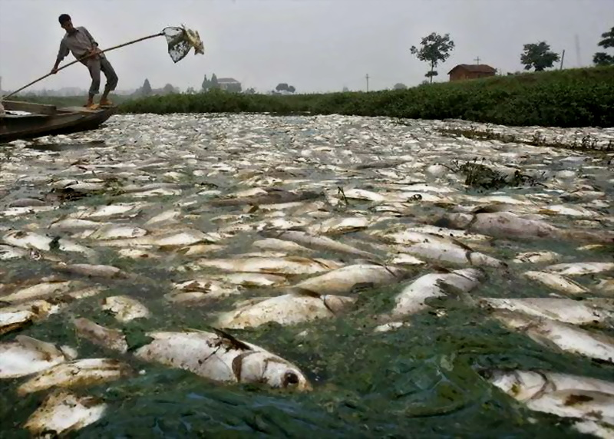
problems of the world
The county air, once clean and fresh, now may be polluted by power stations and factories. Some of our rivers and now empty of fish

Slide 4
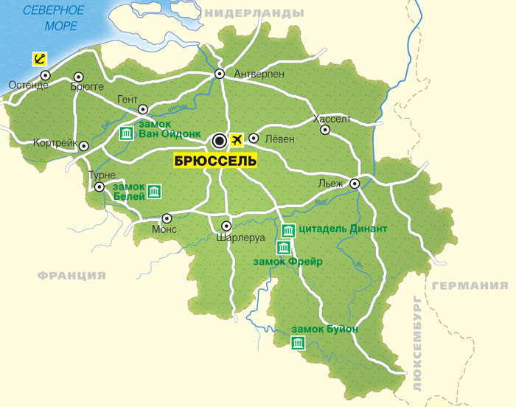
problems of the world
All over the world the forests are disappearing. People cut the trees down because they need wood and paper or new places for farms and houses. Forests the size of Belgium are destroyed every year

Slide 5
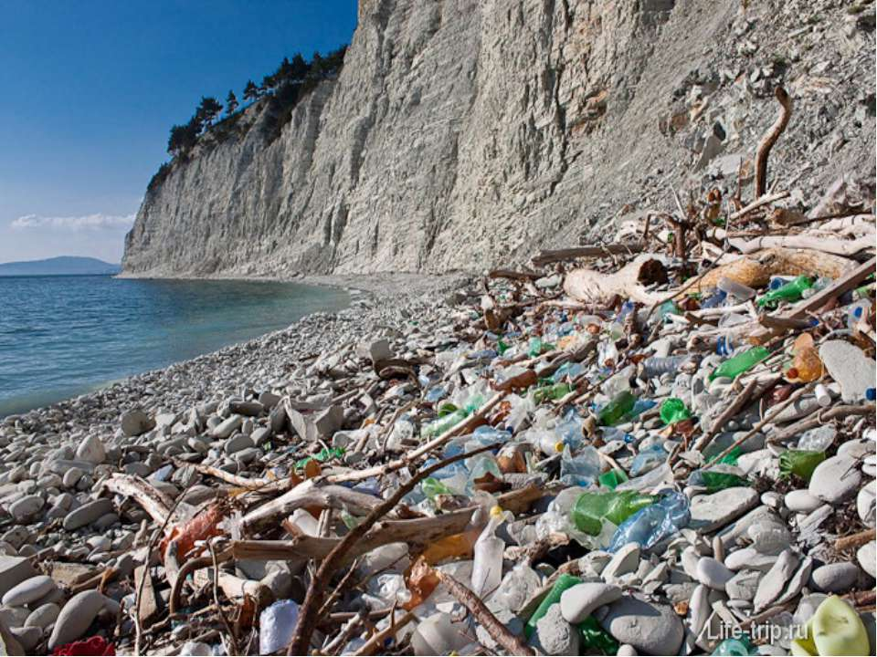
problems of the world
Go to the seaside and you will see the pollution around you. There is a lot of litter on the beaches. Some of it was left by people and some was brought by the water. Pollution is very dangerous for people, wild-life and the environment

Slide 6
Thank you for attention

