Slide 1
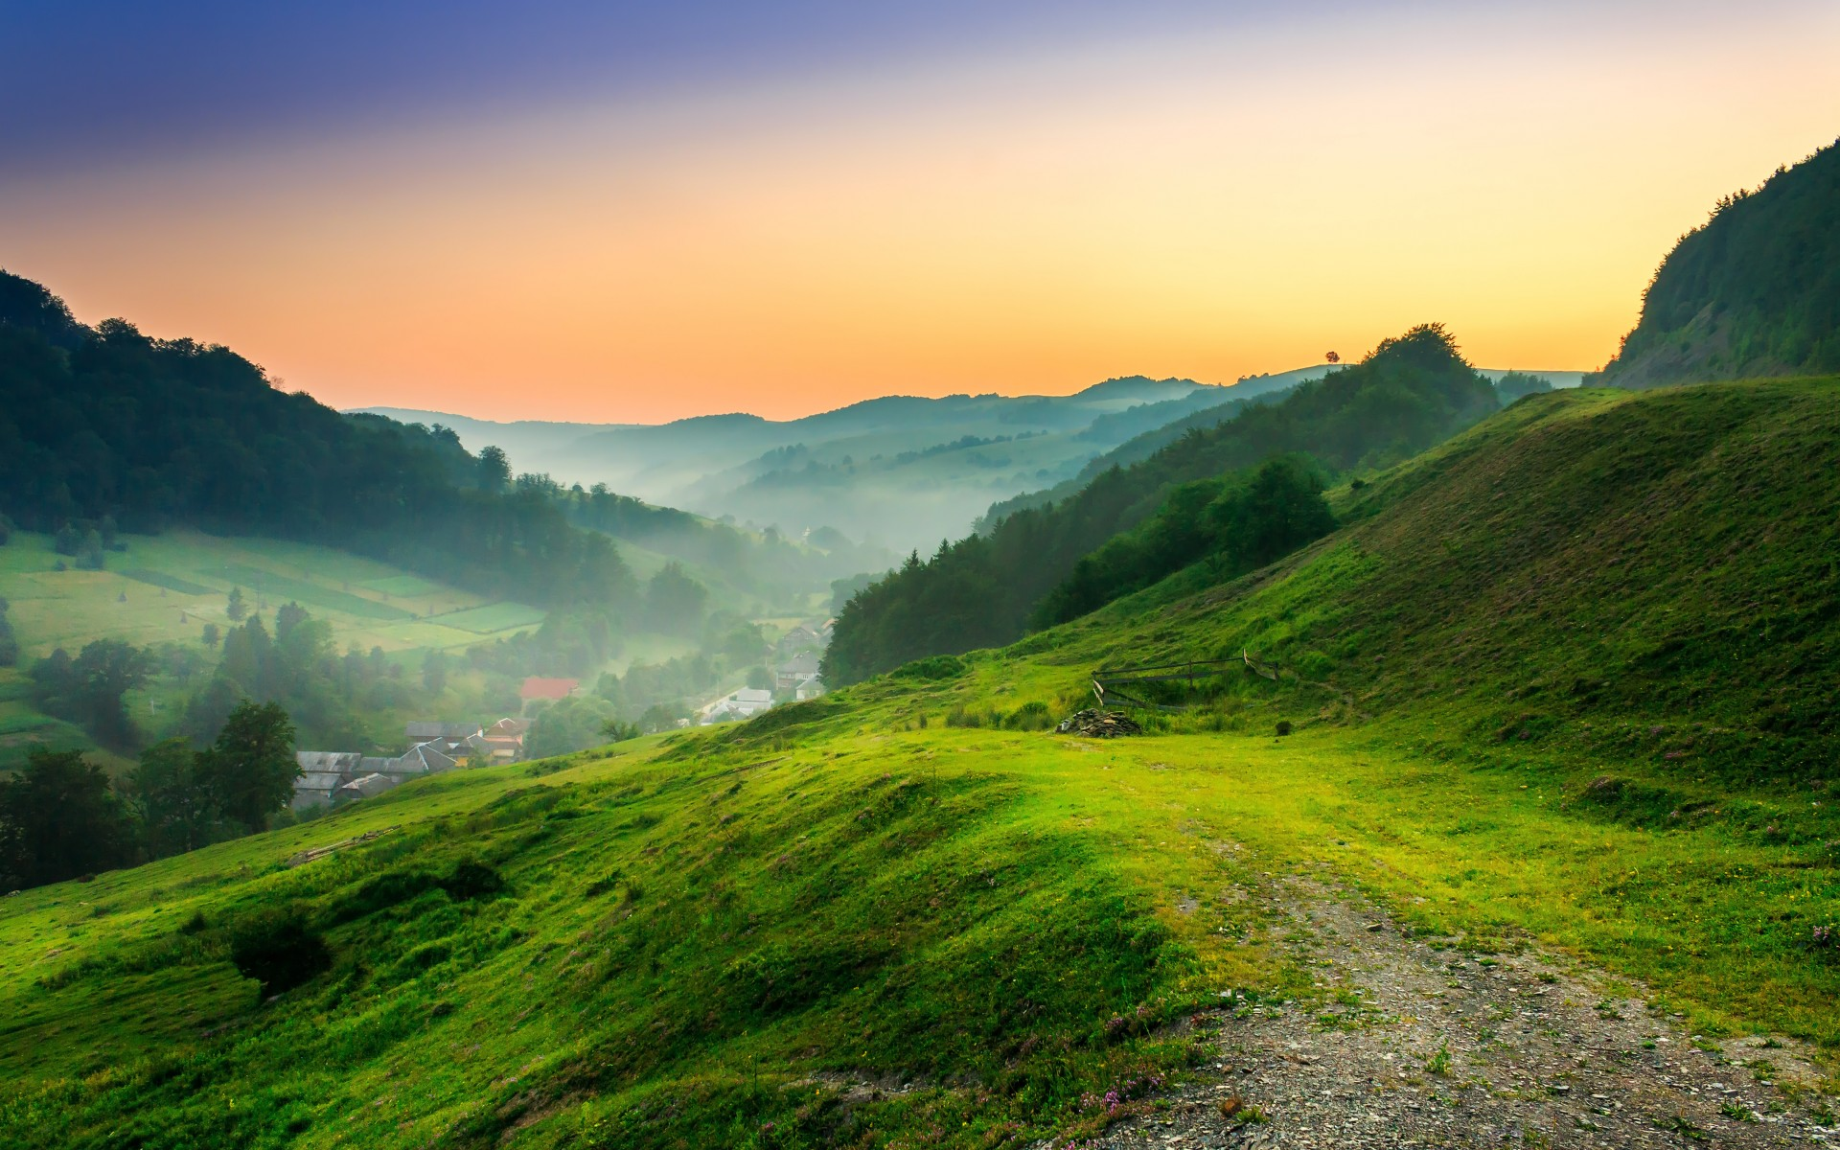
Our planet and we

Slide 2
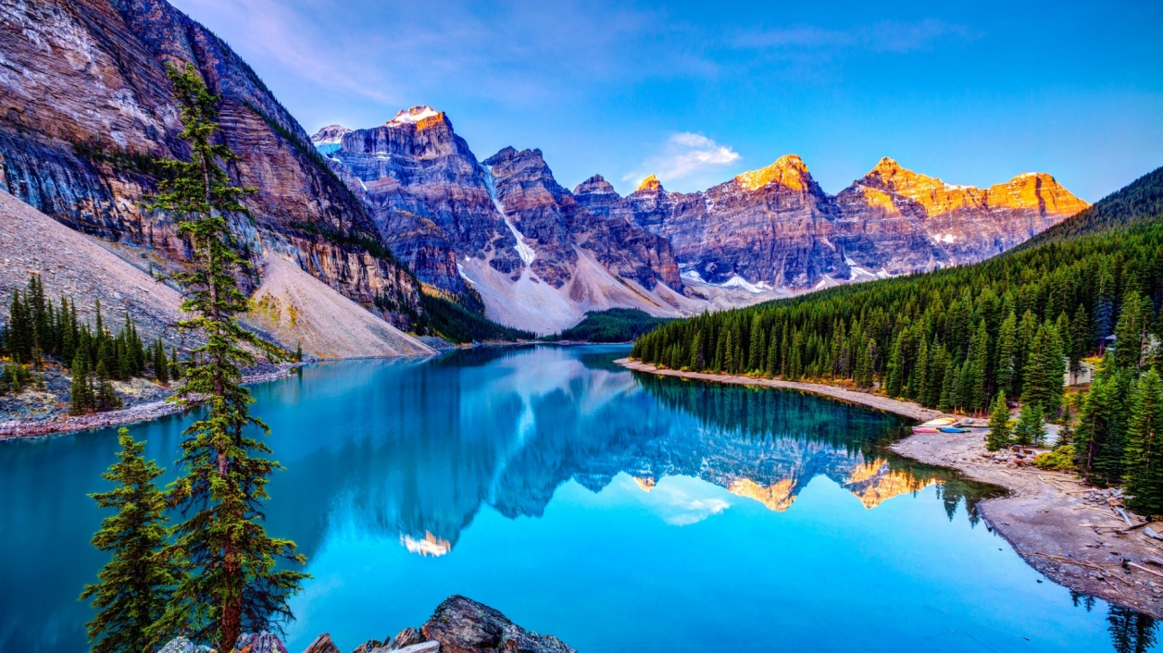
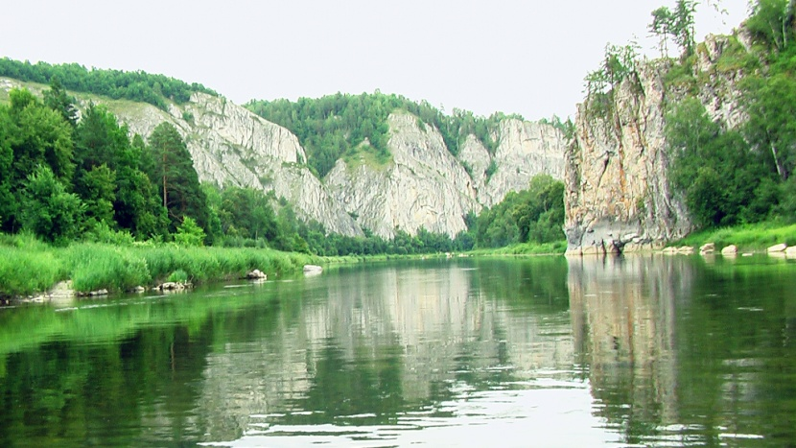
It’s a wonderful world we live in!
For thousand of years the Earth has given support to all forms of life – human beings, animals, birds, fishes, insects and plants.
BUT NOW HUMAN BEINGS ARE KILLING OUR PLANET

Slide 3
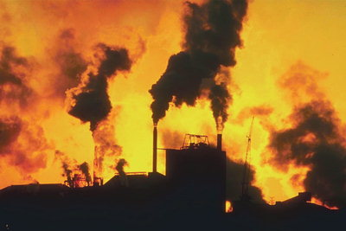
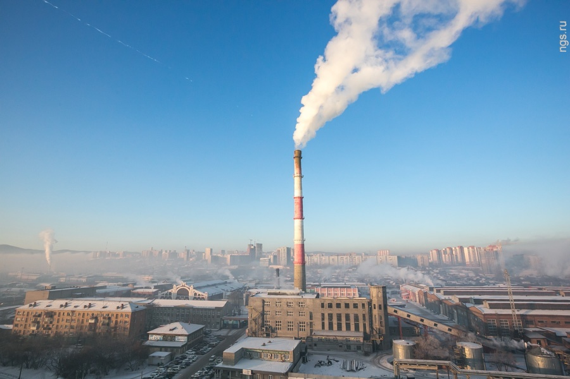
The country air, once clean and fresh, now may be polluted by power stations and factories.

Slide 4
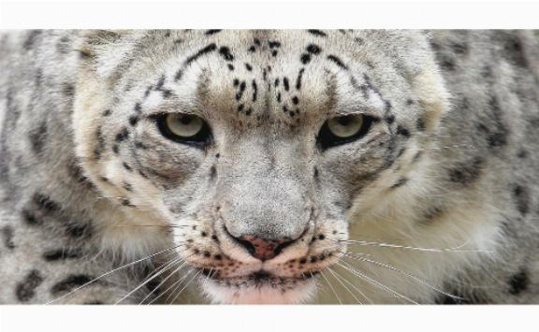
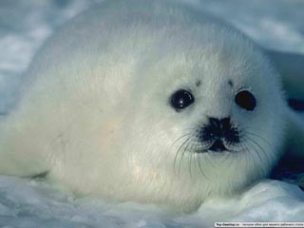
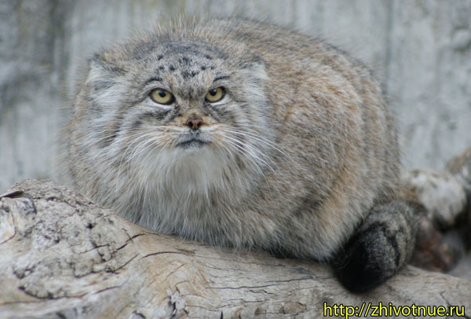
Many species of animals and birds have disappeared. Millions of animals die every year because man has polluted their natural homes.

Slide 5
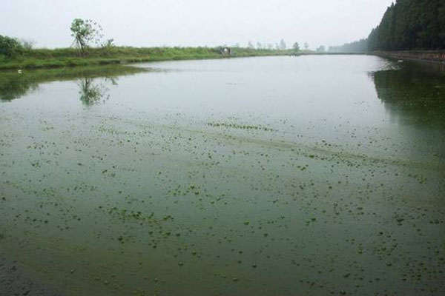
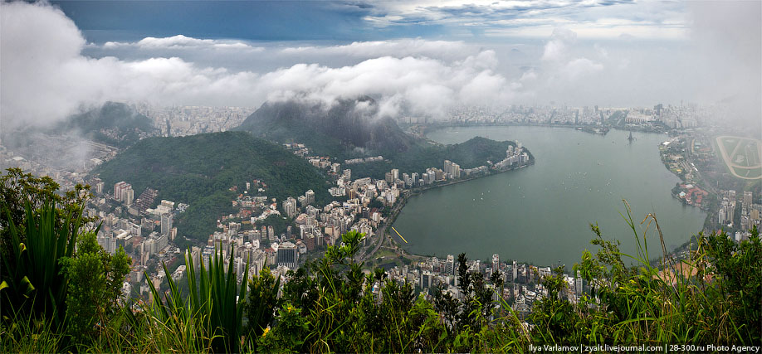
Some of our rivers are now empty to fish. And in some rivers you can even see a thick foam caused by chemical waste.

Slide 6
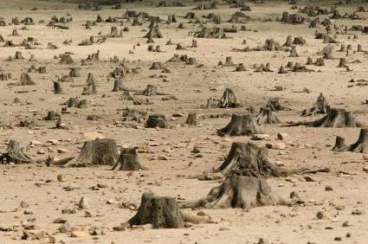
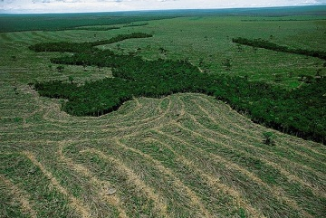
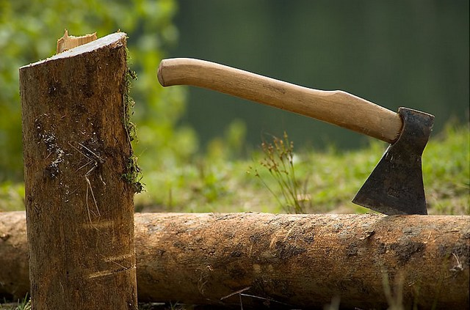
All over the world the forests are disappearing. People cut the trees down because they need wood and paper or new places for farm and houses

Slide 7
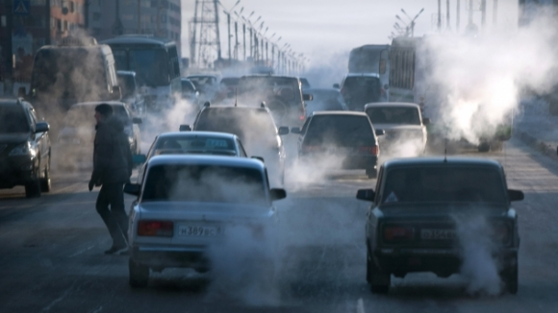
We live among litter and wastes which we have created – fumes of cars, throwaway packaging, ect.

Slide 8
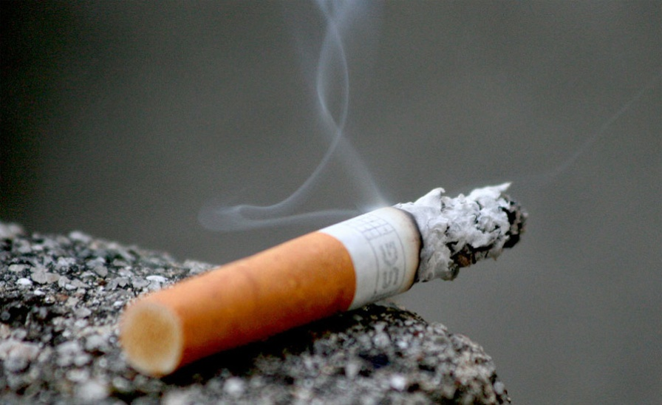
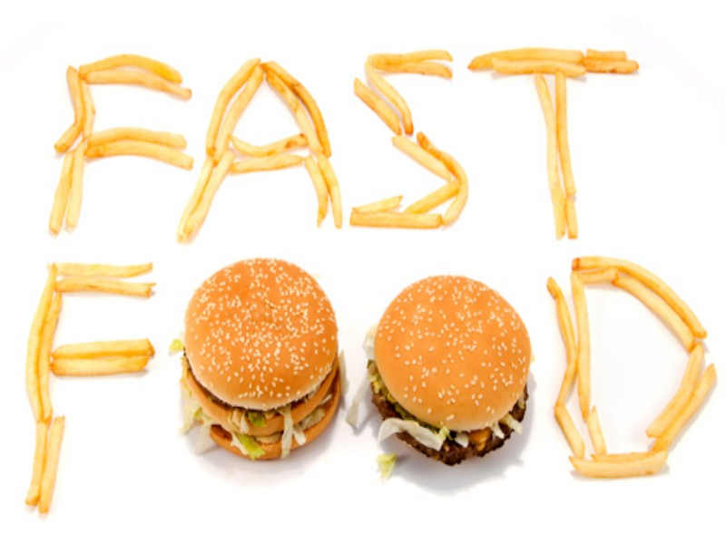
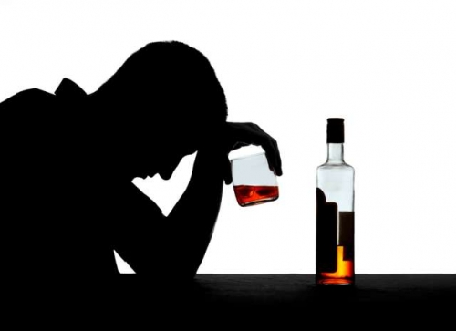
People don’t just pollute the environment. They pollute themselves with cigarettes, alcohol and junk food.

Slide 9
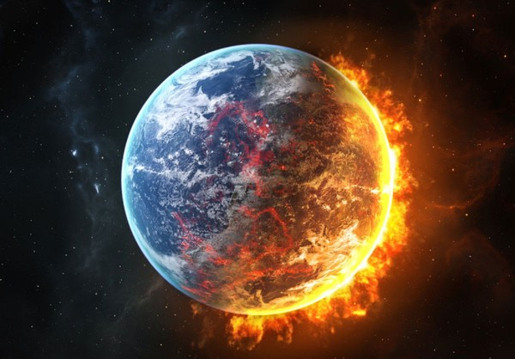
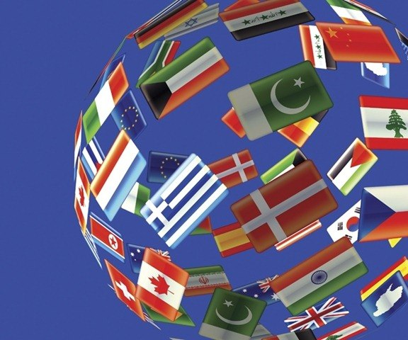
It’s most serious environmental problems.

Slide 10
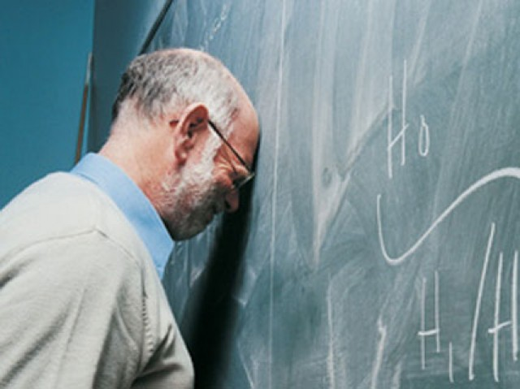
Scientist have made predictions and they are alarming.

